Slide 1
Securing understanding of arithmetic procedures with integers and decimals
Task A: Using a calculator for integer calculations
Find one answer in each row which is the only possible correct answer to the question. Each square covers a single digit.
Question | Answer 1 | Answer 2 | Answer 3
⬛ 3 8 + 4 ⬛ ⬛ | 7 ⬛ | ⬛ 3 ⬛ | 7 ⬛ ⬛ 4
5 ⬛ 8 ⬛ + ⬛ 8 ⬛ 4 | 8 ⬛ ⬛ 1 | 5 4 ⬛ 9 ⬛ | 8 ⬛ 1
⬛ 53 ⬛ + 1 ⬛ 5 ⬛ 2 | ⬛ 3 9 9 | 2 ⬛ ⬛ 0 9 9 | ⬛ 3 ⬛ 9 9
4 3 ⬛ ⬛ 2 + ⬛ 8 6 | 4 ⬛ ⬛ 8 | ⬛ 4 ⬛ 5 | 4 ⬛ ⬛ 2 ⬛
⬛ ⬛ 7 − ⬛ ⬛ 6 | 4 ⬛ ⬛ | ⬛ 3 3 ⬛ | ⬛ 3
⬛ 2 ⬛ 6 − 4 ⬛ ⬛ | 9 ⬛ ⬛ 0 9 | ⬛ 0 0 ⬛ | 9 ⬛ 9
⬛ ⬛ 6 ⬛ 4 − ⬛ 9 ⬛ ⬛ | 3 3 ⬛ 2 | ⬛ 3 ⬛ 6 ⬛ 2 | ⬛ 3 ⬛ ⬛ 2
A
I
B
R
C
A
D
R
E
O
M
E
T
W
H
S
G
F
P
L
N
INTEGER
Rearrange the letters of the correct answers to make a word.

Slide 2
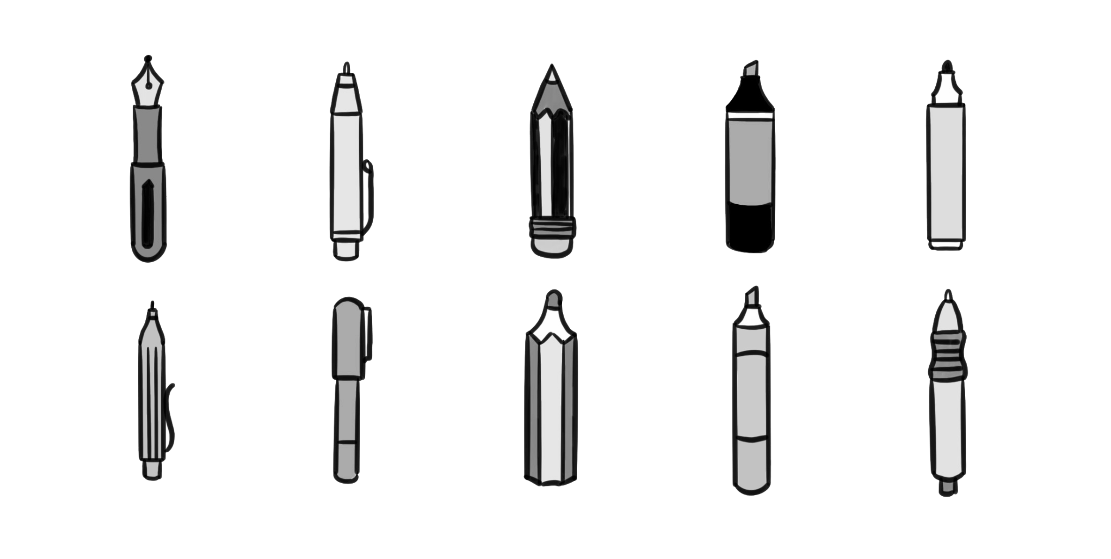
Securing understanding of arithmetic procedures with integers and decimals
Task B: Using a calculator for decimal calculations
Work out the cost of the following:
5 pens and 2 pencils £9.32
4 pens, 6 pencils and 1 highlighter £12.07
1 pen, 4 pencils and 5 highlighters £10.95
12 pencils and 6 highlighters £16.74
8 pens, 5 pencils and 3 highlighters £20.09
175 of each £628.25
£1.56
76p
£1.27
Mathematics in Education and Industry
v2.2

